Slide 1
How You Will Be Marked
Mid-Point Review Presentation Knowledge & Insight
 | Does the interim presentation show sample research and development given the mid-point nature of the project? Does the presentation succinctly cover the development of the project artefact and any appropriate planning? Is the student able to answer questions with clarity knowledge and understanding? | (40%)
Mid-Point Review Presentation Professionalism
 | Has the student handled themselves appropriately throughout the presentations? Is presentation of a suitable length (Max. 15 minutes) and delivered as expected based on the nature of the project? | (20%)

Slide 2

TITLE
Ethan Taylor
22039755
MID-POINT REVIEW

Slide 3

Agenda
Project Introduction
Project Aim
Project Objectives
Literature Review
Research Methodology
Current Developments (optional)
Development Phase Plans
Testing Phase Plans
Gantt Chart of Future Weeks
Questions

Slide 4


Introduction
Artificial intelligence is being used by all industries across the board and the rate at which businesses are picking up and using AI in different ways is increasing as well.
The use of generative artificial intelligence has brought new uses for AI to the games industry.
The question being “How should generative artificial intelligence be used in the development of games.”

Slide 5
Aim & Objectives
Aim
Objectives
To see if people prefer a game to only use human made components at the cost of variation or if they would prefer developers to use generative artificial intelligence to add unique experiences.
Create two versions of the same scenario.
The first using only human-made dialogue.
The second using artificially generated dialogue.
Gather responses and feedback on the scenarios.
Form a conclusion supported by evidence on what the majority prefer.

Slide 6
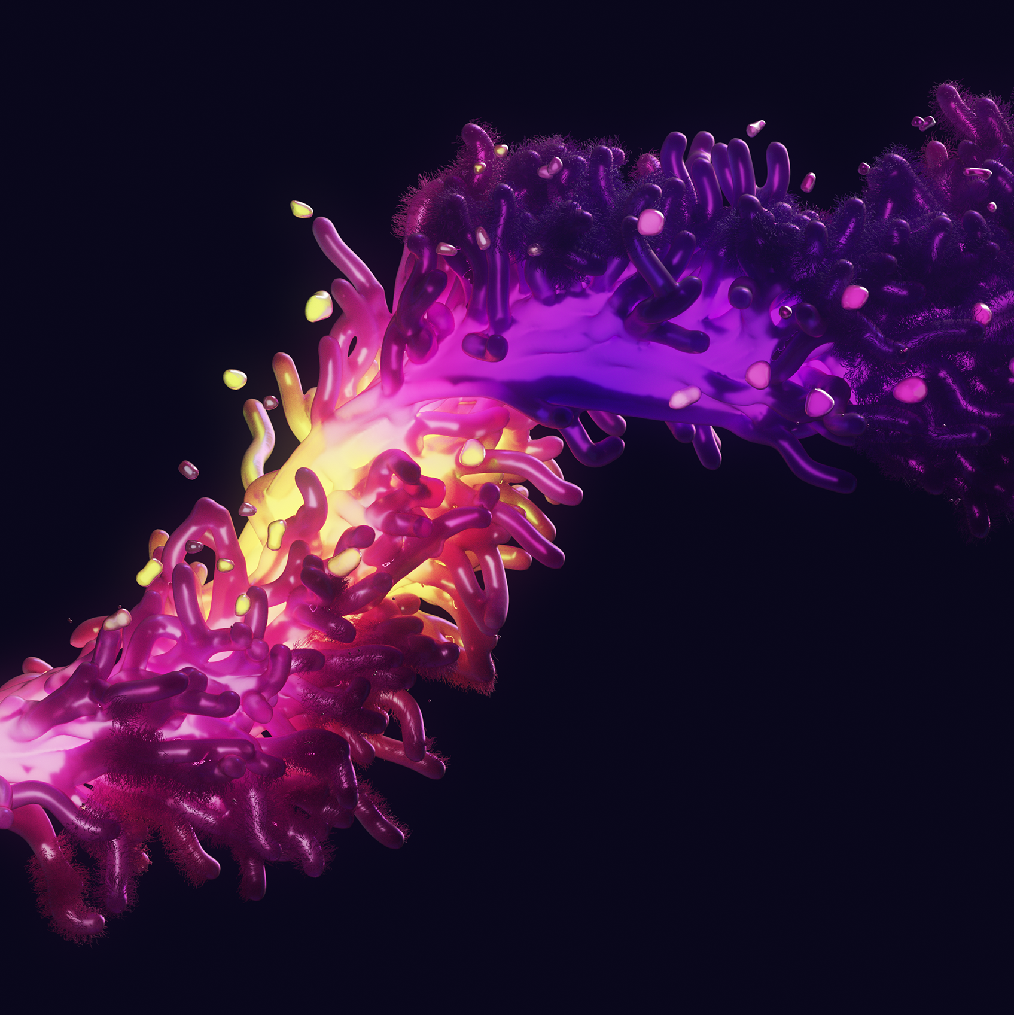


Literature Review
What is generative artificial intelligence?
How is AI/GAI used in games?
What are the benefits/concerns of AI/GAI?

Slide 7
Literature Review
What is generative artificial intelligence?
Reference source, author, date.
[delete as appropriate]

Slide 8
Literature Review
How is AI/GAI used in games?
Reference source, author, date.
[delete as appropriate]

Slide 9
Literature Review
What are the benefits/concerns of AI/GAI?
Benefits:
Being able to allocate resources and personnel to creative tasks.
Reducing stagnation in simpler elements of games.
Concerns:
The effect on people’s critical thinking.
The ethical standpoint of AI replacement.
Reference source, author, date.

Slide 10

Research Methodology
State which methodology you plan to use and why.

Slide 11


Future Developments
Detail the plans for the next stages of the project.
If you have already done some early-stage development, identify what the next steps will be leading into 2025 based on the research you have conducted to influence the next stage.

Slide 12
Timeline Overview
Adjust this accordingly. This is an overview of your Gantt chart. Although it would be good to show your full Gantt chart on the next slide.
October 2024
Project pitch.
Initial meetings.
Ethics.
Begin literature review.
November 2024
Work through the literature review.
Begin to prep for the mid-point viva.
December 2024
Move project into the development phase.
Write up initial test plan.
January 2025
February 2025
Finalise development.
Begin testing phase.
Conduct experiment.
Gather data and evaluate.
Final write up.
Artefact polish.
Submit entire project.
Begin to prep for the final viva.
March 2025
Present final Viva.
Await grade.

Slide 13
Gantt Chart
Delete this and show a screenshot of your Gantt chart here and discuss where you’ve come from and where you’re going with the project.

Slide 14

THANK YOU// QUESTIONS
STUDENT NAME
STUDENT ID
EMAIL

Slide 15
TITLE
PRESENTER NAME
STUDENT ID

Slide 16

Agenda
Topic one
Topic two
Topic three
Topic four
Topic five

Slide 17
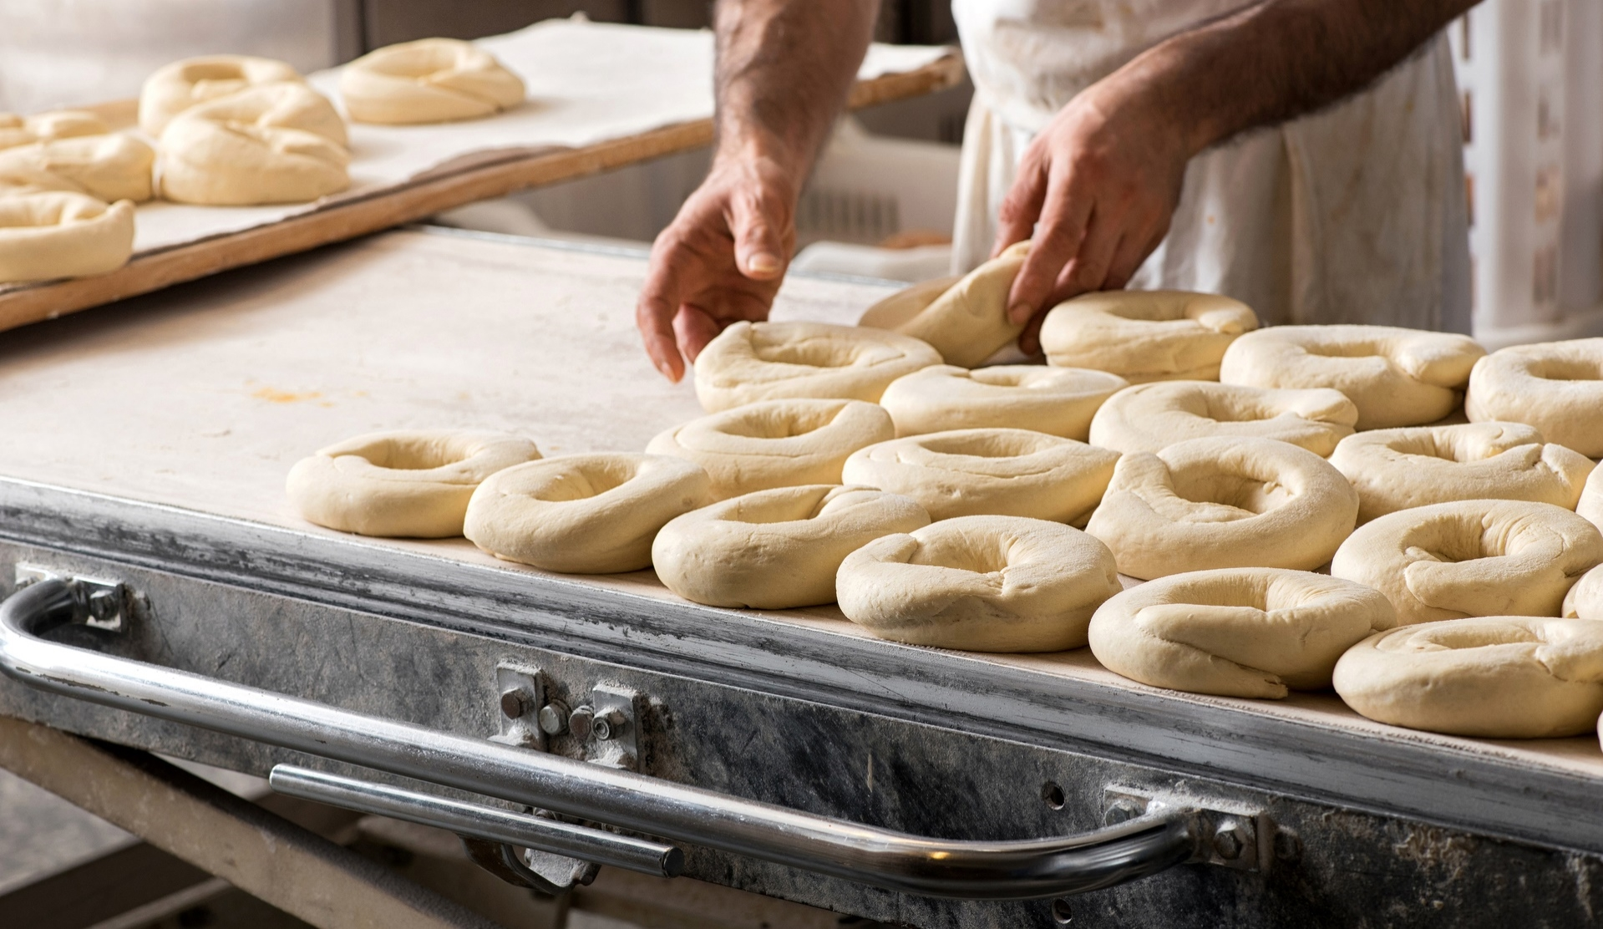
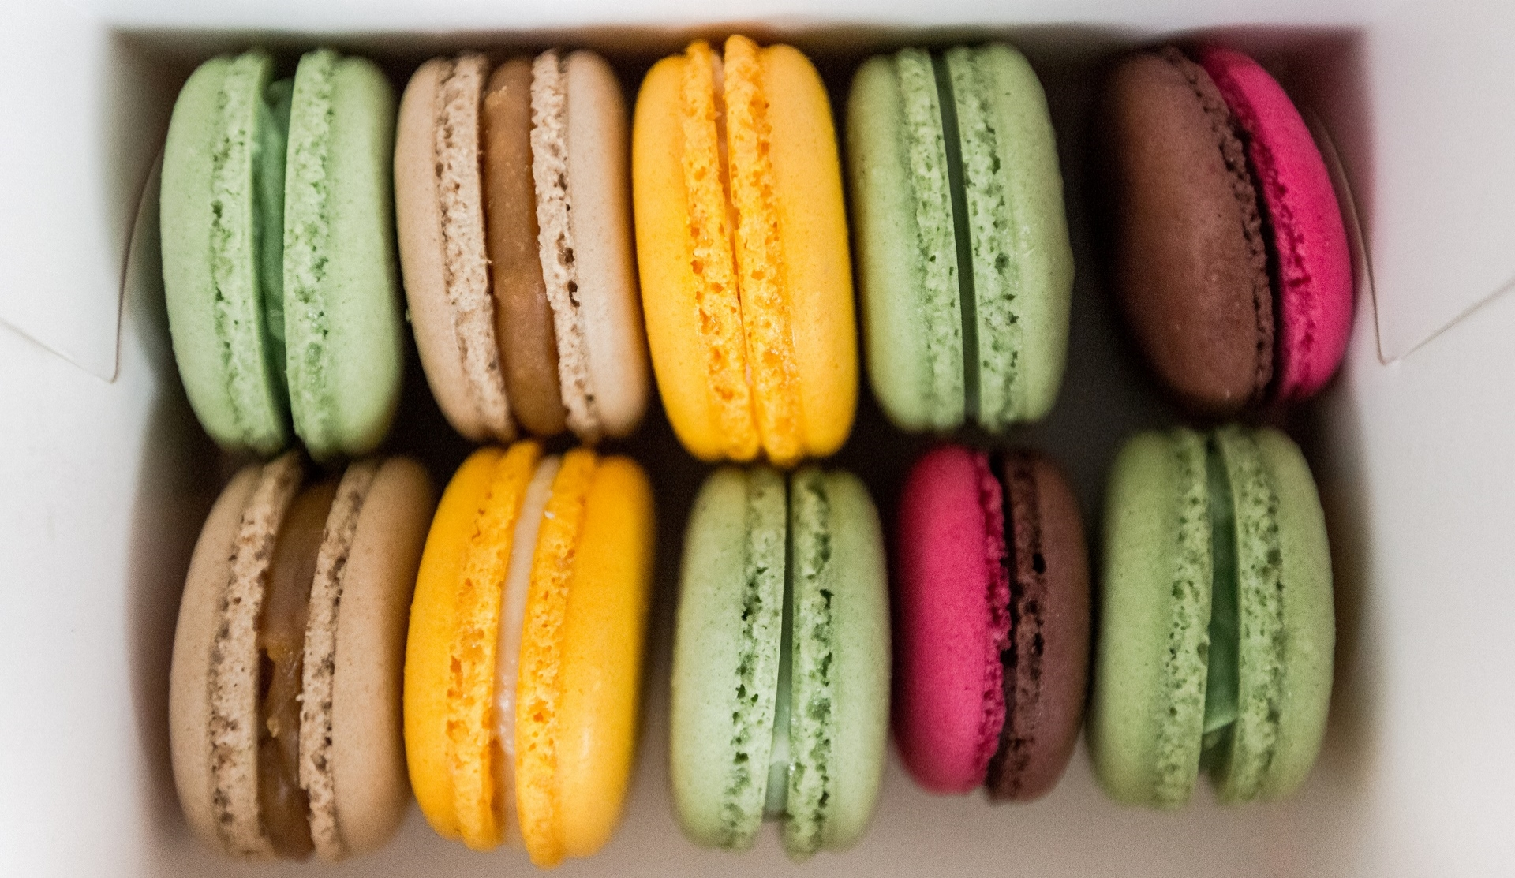
Introduction
With PowerPoint, you can create presentations and share your work with others, wherever they are. Type the text you want here to get started. You can also add images, art, and videos on this template. Save to OneDrive and access your presentations from your computer, tablet, or phone.

Slide 18

TOPIC ONE
SUBTITLE

Slide 19
Chart

Slide 20
Table
 | Category 1 | Category 2 | Category 3 | Category 4
Item 1 | 4.5 | 2.3 | 1.7 | 5
Item 2 | 3.2 | 5.1 | 4.4 | 3
Item 3 | 2.1 | 1.7 | 2.5 | 2.8
Item 4 | 4.5 | 2.2 | 1.7 | 7

Slide 21
The way to get started is to quit talking and begin doing.
Walt Disney

Slide 22
Team
Your Title
Name Title
Name Title
Name Title

Slide 23
Timeline
Title
To start a presentation, go to the Slide Show tab, and select From Beginning.
Title
To display Presenter view, in Slide Show view, on the control bar at the bottom left select the three dots, and then Show Presenter View.
Title
During your presentation, the speaker notes are visible on your monitor, but aren't visible to the audience.
Title
Title
The Notes pane is a box that appears below each slide. Tap it to add notes.
If you can’t see the Notes pane or it is completely minimised, click Notes on the task bar across the bottom of the PowerPoint window.

Slide 24
Content
Subtitle
Subtitle
Add text, images, art, and videos.
Add transitions, animations, and motion.
Save to OneDrive, to get to your presentations from your computer, tablet, or phone.
Add text, images, art, and videos.
Add transitions, animations, and motion.
Save to OneDrive, to get to your presentations from your computer, tablet, or phone.

Slide 25
Content 2
Subtitle
Subtitle
Subtitle
Add text, images, art, and videos.
Add transitions, animations, and motion.
Save to OneDrive, to get to your presentations from your computer, tablet, or phone.
Add text, images, art, and videos.
Add transitions, animations, and motion.
Save to OneDrive, to get to your presentations from your computer, tablet, or phone.
Add text, images, art, and videos.
Add transitions, animations, and motion.
Save to OneDrive, to get to your presentations from your computer, tablet, or phone.

Slide 26



Summary
With PowerPoint, you can create presentations and share your work with others, wherever they are. Type the text you want here to get started. You can also add images, art, and videos on this template. Save to OneDrive and access your presentations from your computer, tablet, or phone.

Slide 27

THANK YOU
PRESENTER NAME
EMAIL WEBSITE

